Slide 1


Slide 2
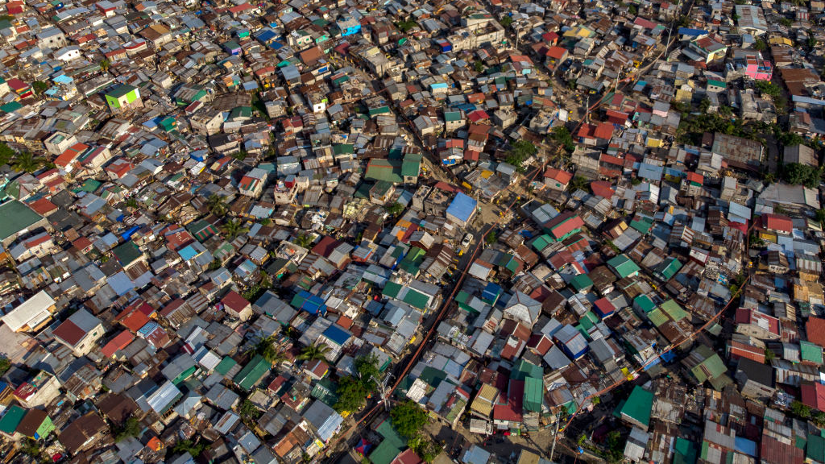
2.7 billion

Slide 3
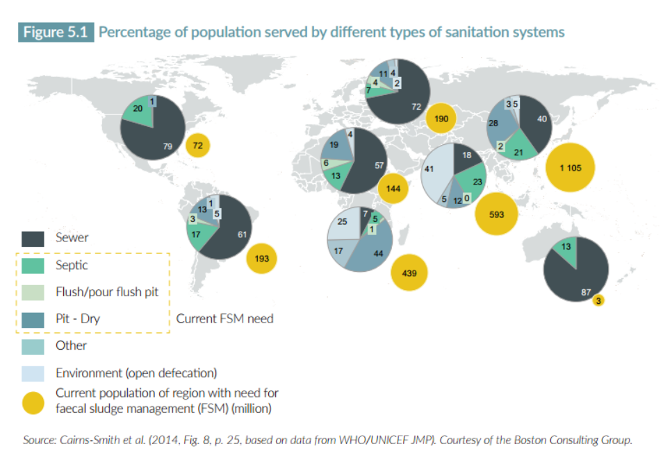
Share of population served by different sanitation technologies, by region

Slide 4
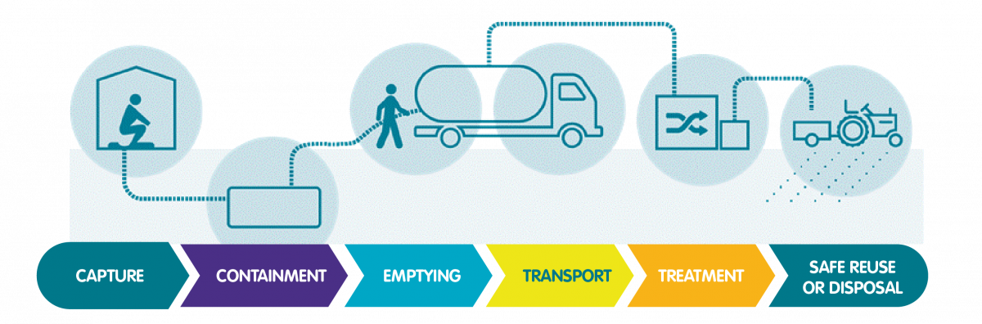

Slide 5
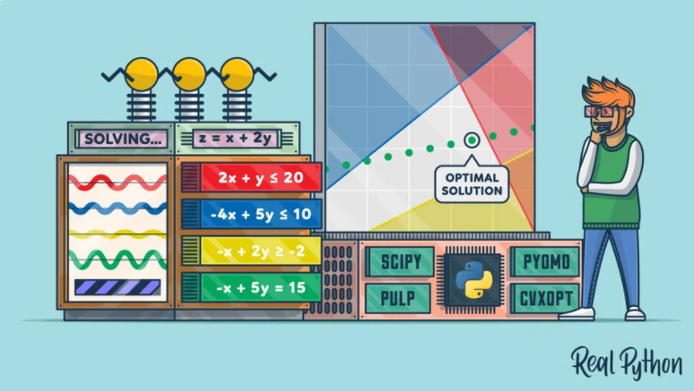

Slide 6

Objective : Minimizing operational cost Constraint : Meet demand in each locality

Slide 7
Cost
Time
Distance

Slide 8
Treatment plants
Garages
DISTANCE & TRAVEL TIME
Localities
DISTANCE & TRAVEL TIME
DISTANCE & TRAVEL TIME

Slide 9
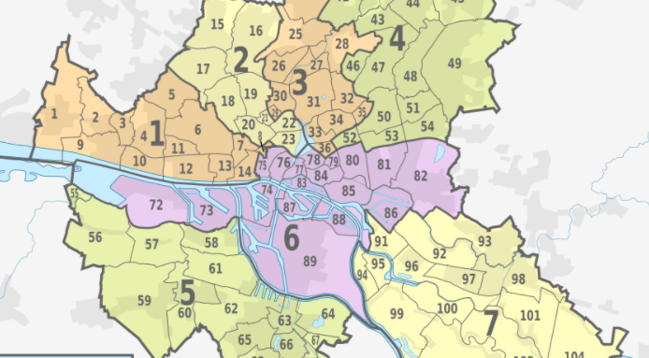

Slide 10
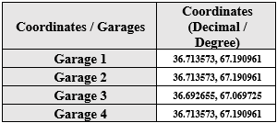
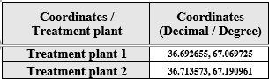

Slide 11
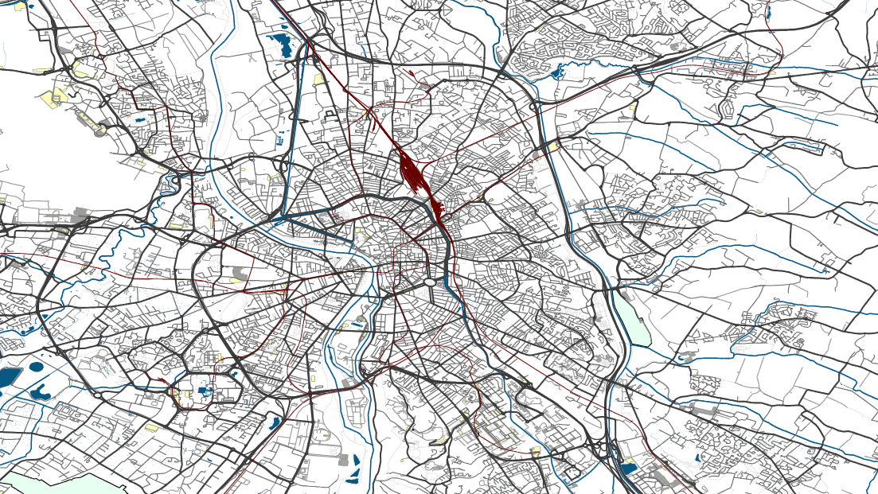

Slide 12
